Slide 1


Implement the SDR representation in the MAUI Application
Information Technology Course Module Software Engineering
by Damir Dobric/ Andreas Pech
Presented by: Team_MAUI
Saitejaswini Vemula (1507647)
satejaswini.vemula@stud.fra-uas.de
Aswini Thirumaran (1510315)
aswini.thirumaran@stud.fra-uas.de

Slide 2
Agenda
Problem Statement and Objective
Introduction
Workflow Architecture
Process flow of MAUI Application
Implementation of MAUI application
Test Cases with Results
Conclusion
References

Slide 3

Problem Statement and Objective
Project Problem Statement:
Design a MAUI application to implement the SDR representation.
Project Objective:
The visualization of Sparse Distributed Representations (SDRs) poses a significant challenge in both neuroscience and machine learning due to the lack of accessible and user-friendly tools. Understanding the intricate structure and applications of SDRs requires effective visualization methods, which are currently limited.
Our goal is to develop a user-friendly multi platform app UI (MAUI) application, leveraging the NeocortexApi framework and OxyPlot libraries, to democratize SDR visualization. By doing so, we aim to bridge the gap between neuroscience, machine learning, and software engineering, empowering a diverse range of users to explore and analyze SDRs effectively.

Slide 4
Introduction
Sparse Distributed Representation (SDR) stands as a cornerstone in both neuroscience and machine learning, enabling the efficient encoding and representation of information across various domains. However, understanding the structure and applications of SDRs relies heavily on effective visualization tools. Recognizing this need, our project focuses on developing a multiplatform app UI (MAUI) application that leverages the NeocortexApi framework and plotting libraries like OxyPlot.
Our motivation stems from the necessity for accessible and user-friendly tools to explore and analyze SDRs. By democratizing SDR visualization, we aim to make it available to a wide range of users, including researchers, educators, and hobbyists, thus bridging the gap between neuroscience, machine learning, and software engineering. Through an intuitive interface and efficient drawing functionality, our application seeks to empower users to delve into the complex structures and patterns encoded within their SDRs.

Slide 5
A. Hierarchical Temporal Memory (HTM):
1. HTM is a machine learning framework inspired by the neocortex, modeling information processing and temporal sequence learning.
2. Sparse Distributed Representations (SDRs) are fundamental to HTM, representing input data as binary vectors with few active bits.
B. Encoder:
1. Converts incoming data into sparse distributed representations (SDRs) with a small fraction of active bits.
2. Maintains sparsity to efficiently encode complex patterns, unlike dense representations.
C. Spatial Pooler:
1. Generates a second SDR representing the activation state of mini-columns based on input SDRs.
2. Neurons in mini-columns connect to a subset of input SDR bits, with synaptic connections adapting via permanence values.
D. Temporal Pooler:
1. Composed of mini-columns with HTM neurons, forming cortical columns for temporal memory.
2. Synaptic connections between cells indicate temporal relationships, allowing prediction and learning of temporal patterns.
E. Active Sparse Distributed Representation (SDR):
1. Represents relevant features in input data through active dimensions in binary vectors.
2. Facilitates distributed and parallel processing, enabling HTM systems to learn complex temporal patterns and perform cognitive tasks.

Slide 6
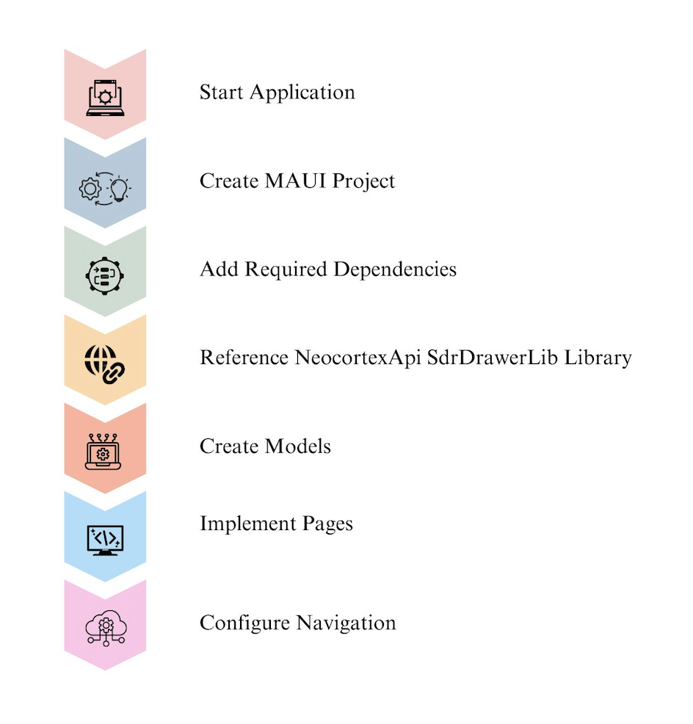
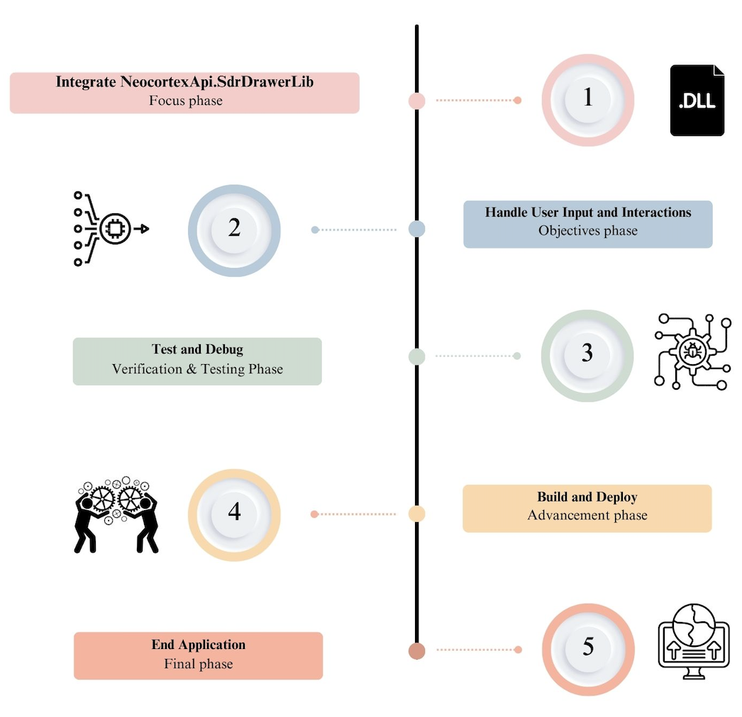
Workflow Architecture
Fig. 1 Workflow Architecture

Slide 7
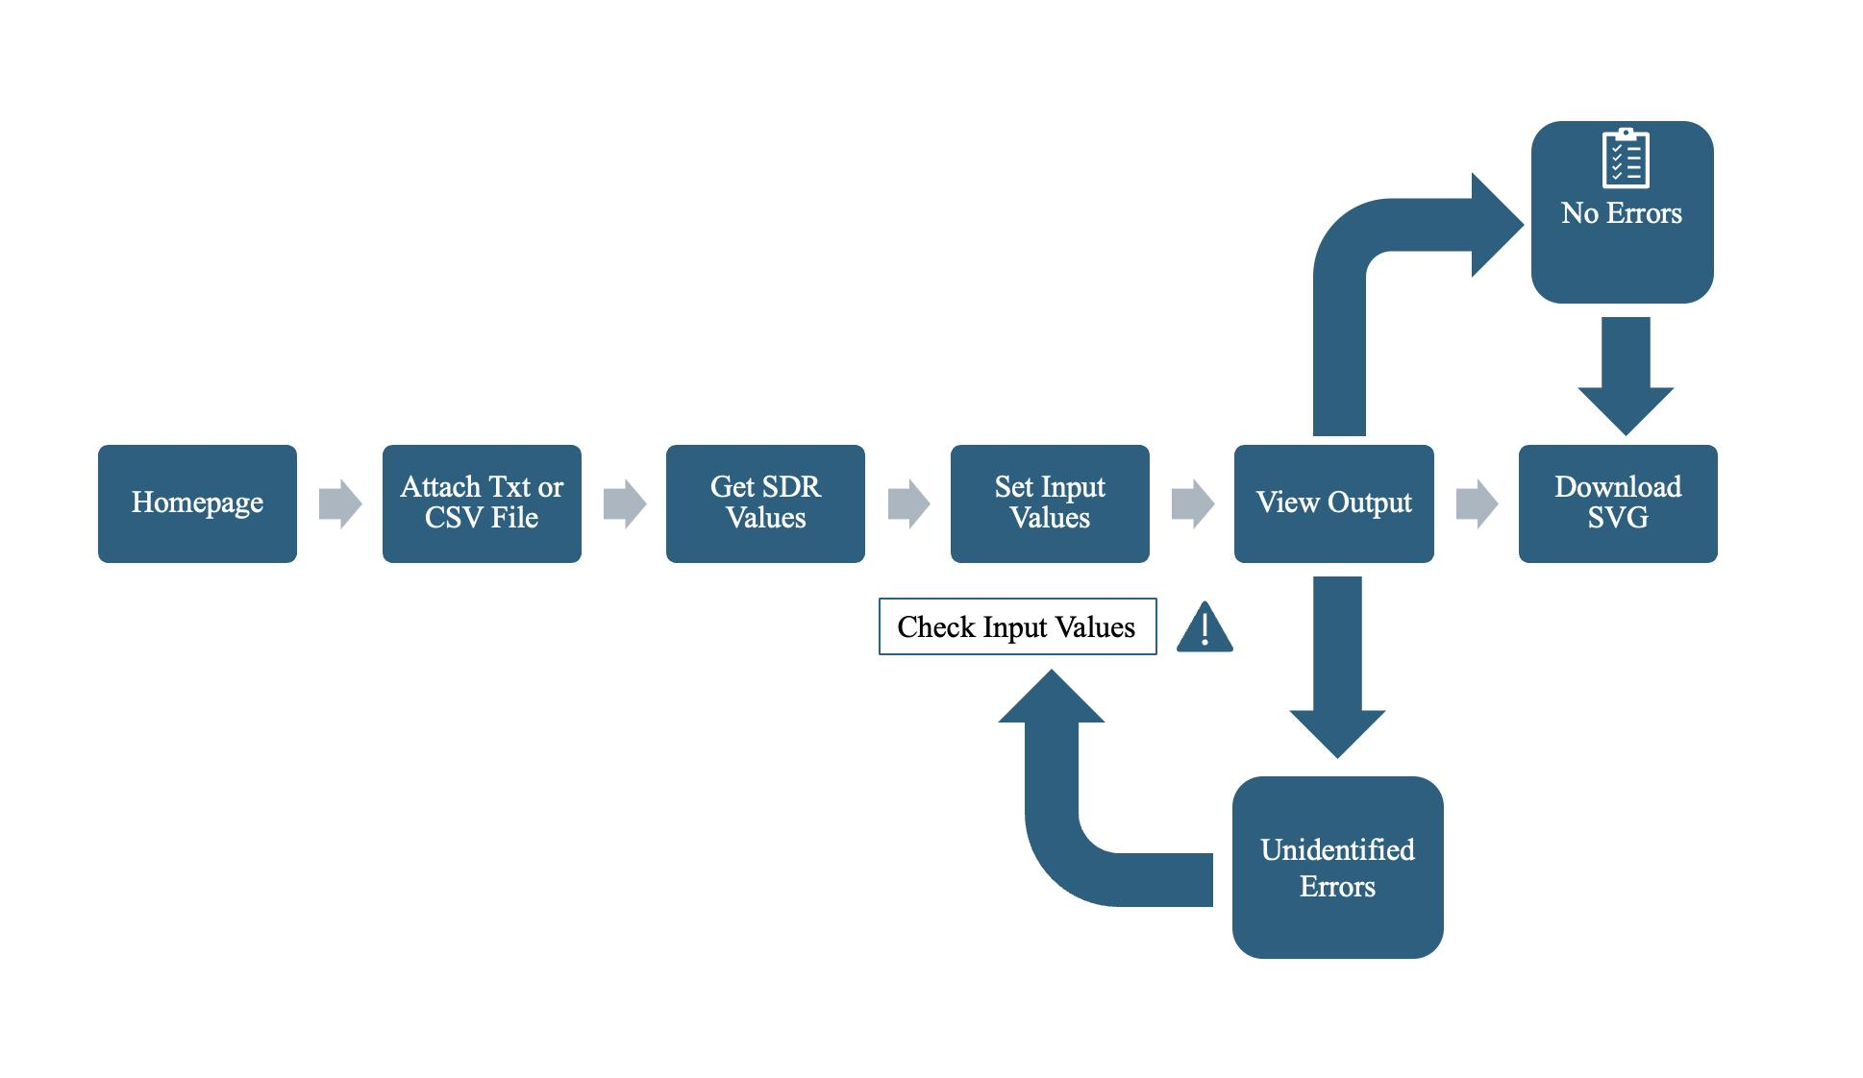
Process flow of MAUI Application
Fig. 2 Application Workflow

Slide 8
Implementation of MAUI Application
Methods used for Drawing Functionality:
SdrHelper class
The class features a method, newgeneratesdr, for creating an SDR plot using provided data by initializing lists, processing CSV data for unique cell values, and extracting parameters from the model. It sets the current SdValueModel in Filedatahelper and utilizes SdrDrawer to plot activity in both vertical and horizontal orientations.
Filedatahelper class
Centralizes management of file data, image paths, and SdValueModel instances using static fields for storage, ensuring single-instance access. Static methods enable straightforward retrieval and updating of these values across the application.
Plotting activity
The PlotActivityVertically method from the SdrDrawer class limits cycle numbers based on active cells and creates plots using rectangle bars to represent cells in columns. It highlights specific touches with rectangle bars and includes axes for scaling and labeling. Both vertical and horizontal plots use similar methods for visualization and SVG file generation.

Slide 9
Implementation of MAUI Application
1. File-handling:
Users can input Sparse Distributed Representation (SDR) values either by pasting them into a text box or by uploading a TXT or CSV file. This dual approach offers flexibility and convenience for processing SDR data efficiently.
2. Data processing:
Users can use both default and manual input values for efficient processing. Linear axes (X-axis and Y-axis) are configured with specific properties to define their positions, titles, number of touches, maxcells are displayed ranges based on input parameters.
3. Highlight Touch:
This feature visually emphasizes a selected touch within each column of the SDR visualization, adding a rectangle bar item to highlight the specific touch and its associated cells.
4. Output page:
The application showcases SDR plots with toggleable views (vertical and horizontal) and real-time adjustable max cycles via a slider. A comparison tool allows for side-by-side viewing of plots to identify patterns and anomalies. Users can easily navigate between sections and download SVG files for further analysis or sharing.

Slide 10
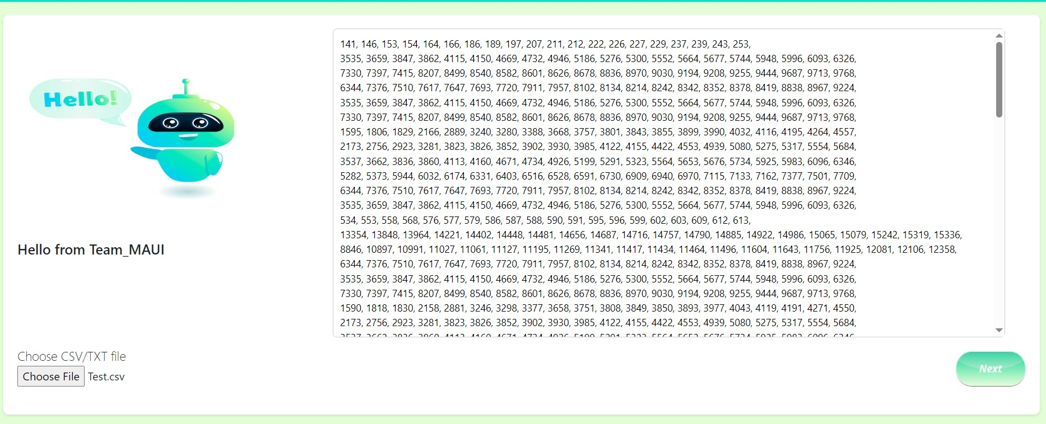
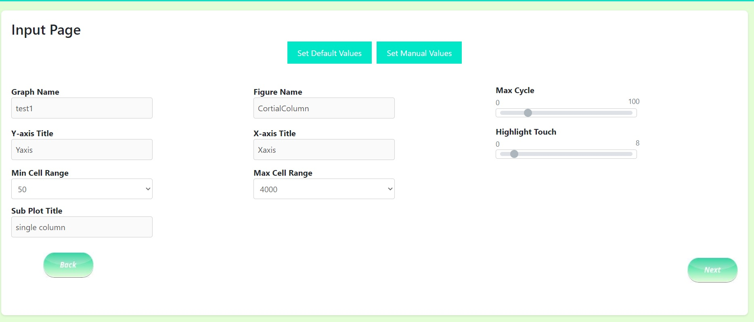
Implementation of MAUI Application
Fig. 3 File Handling
Fig. 4 Data Processing

Slide 11
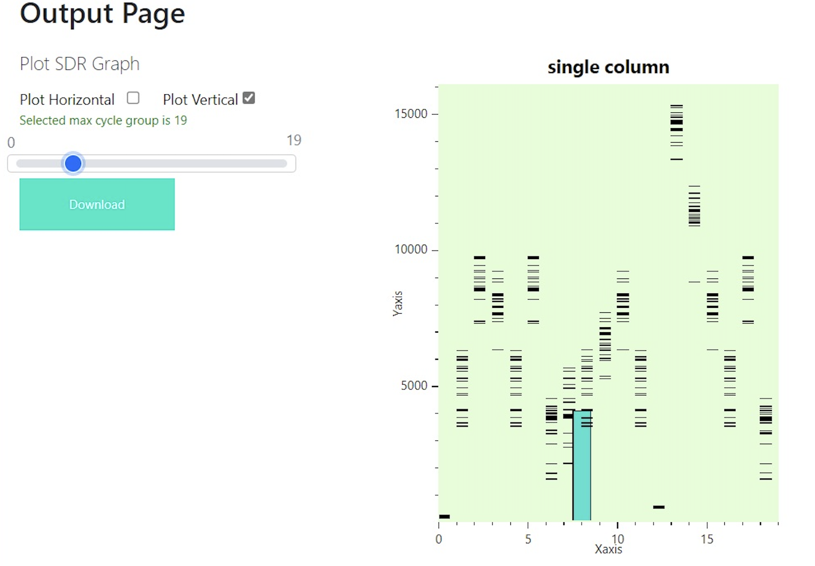
Test Cases with Results
Scenario 1 - Default input parameters
Graph Name: test1 → This parameter specifies the name of the graph that is being generated.
Figure Name: CorticalColumn → This parameter specifies the name of the figure being generated.
Maximum Cycles: 19 → This parameter sets the maximum number of cycles that will be run.
Y-Axis Title: Yaxis → This parameter specifies the title of the y-axis.
X-Axis Title: Xaxis → This parameter specifies the title of the x-axis.
Highlight Touch: 8 → This parameter sets the number of cells to highlight when a touch event is detected.
Minimum Number of Cells: 5 → This parameter sets the minimum number of cells that can be displayed.
Maximum Number of Cells: 4000 → This parameter sets the maximum number of cells that can be displayed.
Subplot Title: Single Column → This parameter sets the title of the subplot.
Fig. 5 Output of default input parameters

Slide 12
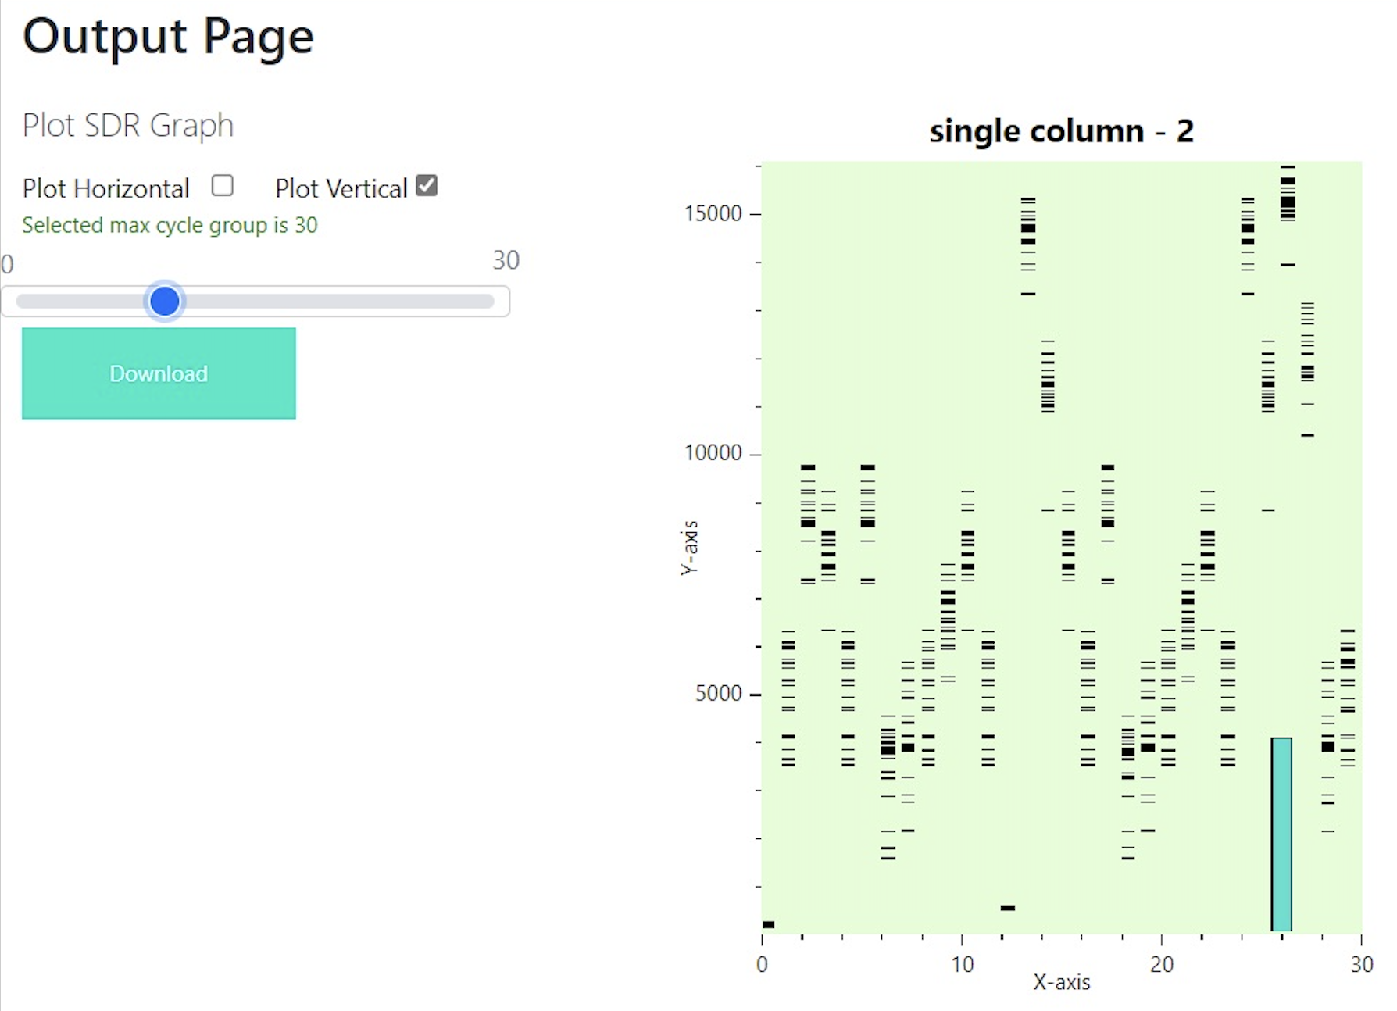
Scenario 2 - Manually changed input parameters
The input values are changed by using the set manual values button,
Graph name: Test 2
Maximum cycle: 30
Highlight touch: 26
Minimum cell: 70
Subplot title: Single Column - 2
Fig. 6 Output of manually changed input parameter

Slide 13
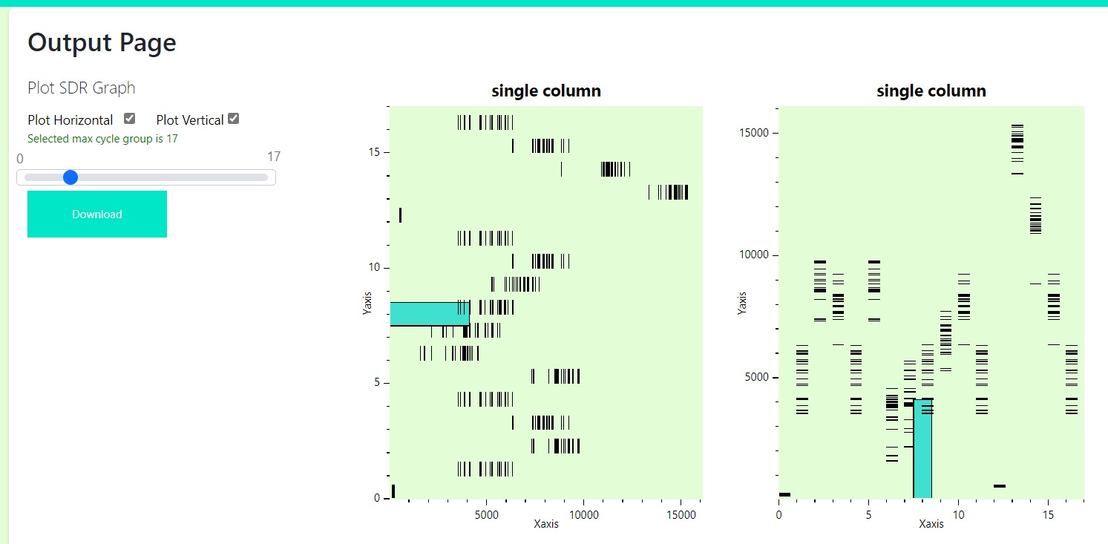
Scenario 3 - Both Horizontal and Vertical Plot
Fig. 7 Output page with both horizontal & Vertical plot

Slide 14

Conclusion
An easy-to-use MAUI desktop application has been developed for visualizing Sparse Distributed Representations (SDRs) using the NeocortexApi.SdrDrawerLib library.
The main objective of this application is to make SDR visualization accessible to researchers, educators, and enthusiasts by integrating advanced plotting features into a user-friendly interface.
The application simplifies input parameter handling, SDR diagram generation, and result analysis, thereby promoting innovation and understanding across diverse fields.

Slide 15
References
[1]. J. Hawkins and S. Ahmad, “Why Neurons Have Thousands of Synapses, a Theory of Sequence Memory in Neocortex,” Frontiers in Neural Circuits, vol. 10, no. 23, Mar. 2016, doi: https://doi.org/10.3389/fncir.2016.00023.
[2]. S. Hunter, “Introducing .NET Multi-platform App UI,” .NET Blog, May 19, 2020. https://devblogs.microsoft.com/dotnet/introducing-net-multi-platform-app-ui/
[3]. A. Barua, D. Muthirayan, P. P. Khargonekar, and M. A. Al Faruque, “Hierarchical Temporal Memory based One-pass Learning for Real-Time Anomaly Detection and Simultaneous Data Prediction in Smart Grids,” IEEE Transactions on Dependable and Secure Computing, pp. 1–1, 2020, doi: https://doi.org/10.1109/tdsc.2020.3037054.
[4]. J. Hawkins, S. Ahmad, and Y. Cui, “A Theory of How Columns in the Neocortex Enable Learning the Structure of the World,” Frontiers in Neural Circuits, vol. 11, no. 81, Oct. 2017, doi: https://doi.org/10.3389/fncir.2017.00081.
[5] J. Hawkins, “Hierarchical Temporal Memory (HTM) Whitepaper,” Numenta, Sep. 12, 2011. https://www.numenta.com/resources/research-publications/papers/hierarchical-temporal-memory-white-paper/ (accessed Mar. 01, 2024).
[6] S. &. H. .. Ahmad, “ “Properties of sparse distributed representations and their application to hierarchical temporal memory.,”,” 2011. [Online]. Available: doi: https://doi.org/10.48550/arXiv.1503.07469

Slide 16


